Slide 1
Hearing Health for Musicians
Joe Pellegrino, AuD, CCC-A
Syracuse University
Associate Teaching Professor
Director, Gebbie Hearing Clinic

Slide 2
Why Am I Here?
Risks for musicians
Four times as likely to develop noise induced hearing loss than the general public.
57% more likely to develop tinnitus

Slide 3
Famous Musicians with Hearing Loss
Neil Young
Phil Collins
Sting
Bono (U2)
Pete Townsend (The Who)
Paul Stanley (Kiss)
Eric Clapton
Lars Ulrich (Metallica)
Barbara Streisand
Ozzy
Anthony Kiedis (Red Hot Chili Peppers)
Moby
Chris Martin (Cold Play)
Liam Gallagher (Oasis)
Dave Pirner (Soul Asylum)
Will.i.am (Black Eyed Peas)

Slide 4
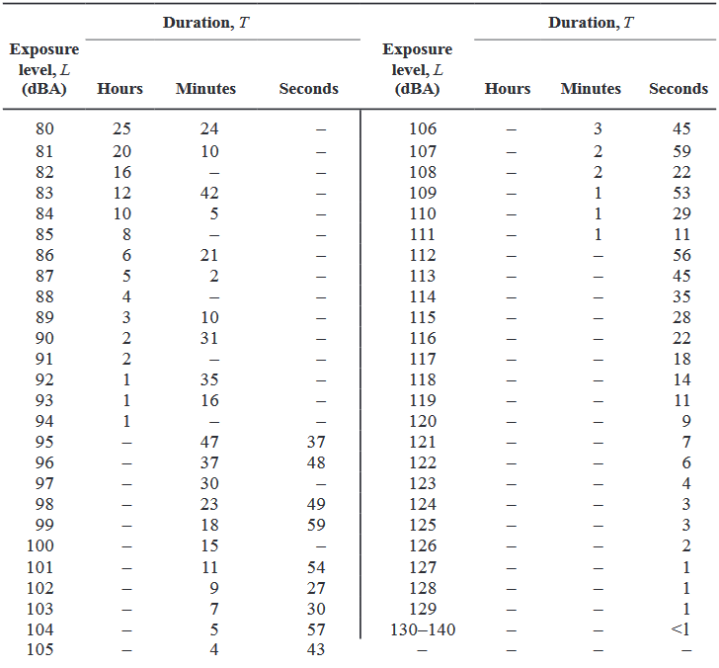
How Loud is Too Loud?

Slide 5
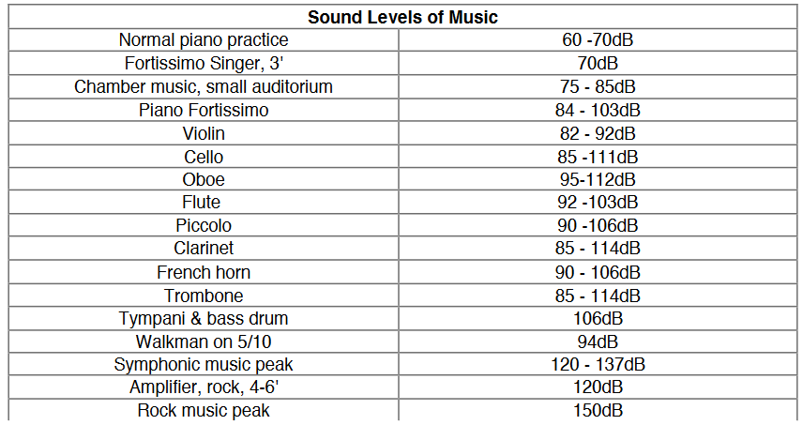
Sound Levels of Music

Slide 6
What is Noise Induced Hearing Loss?
Gradual or Rapid Onset
Permanent Sensorineural Loss
Centered at 4000 Hz
Loss of speech clarity
Impaired pitch perception

Slide 7
What Can You Do?
Protect your ears
Be aware of the sound levels around you
Give yourself quiet breaks
Wear hearing protection
Foam roll down plug $5
Non-custom filtered $25
Custom ear molds $110
Filtered plug with attenuation of 9, 15, or 25 dB $155

